Slide 1
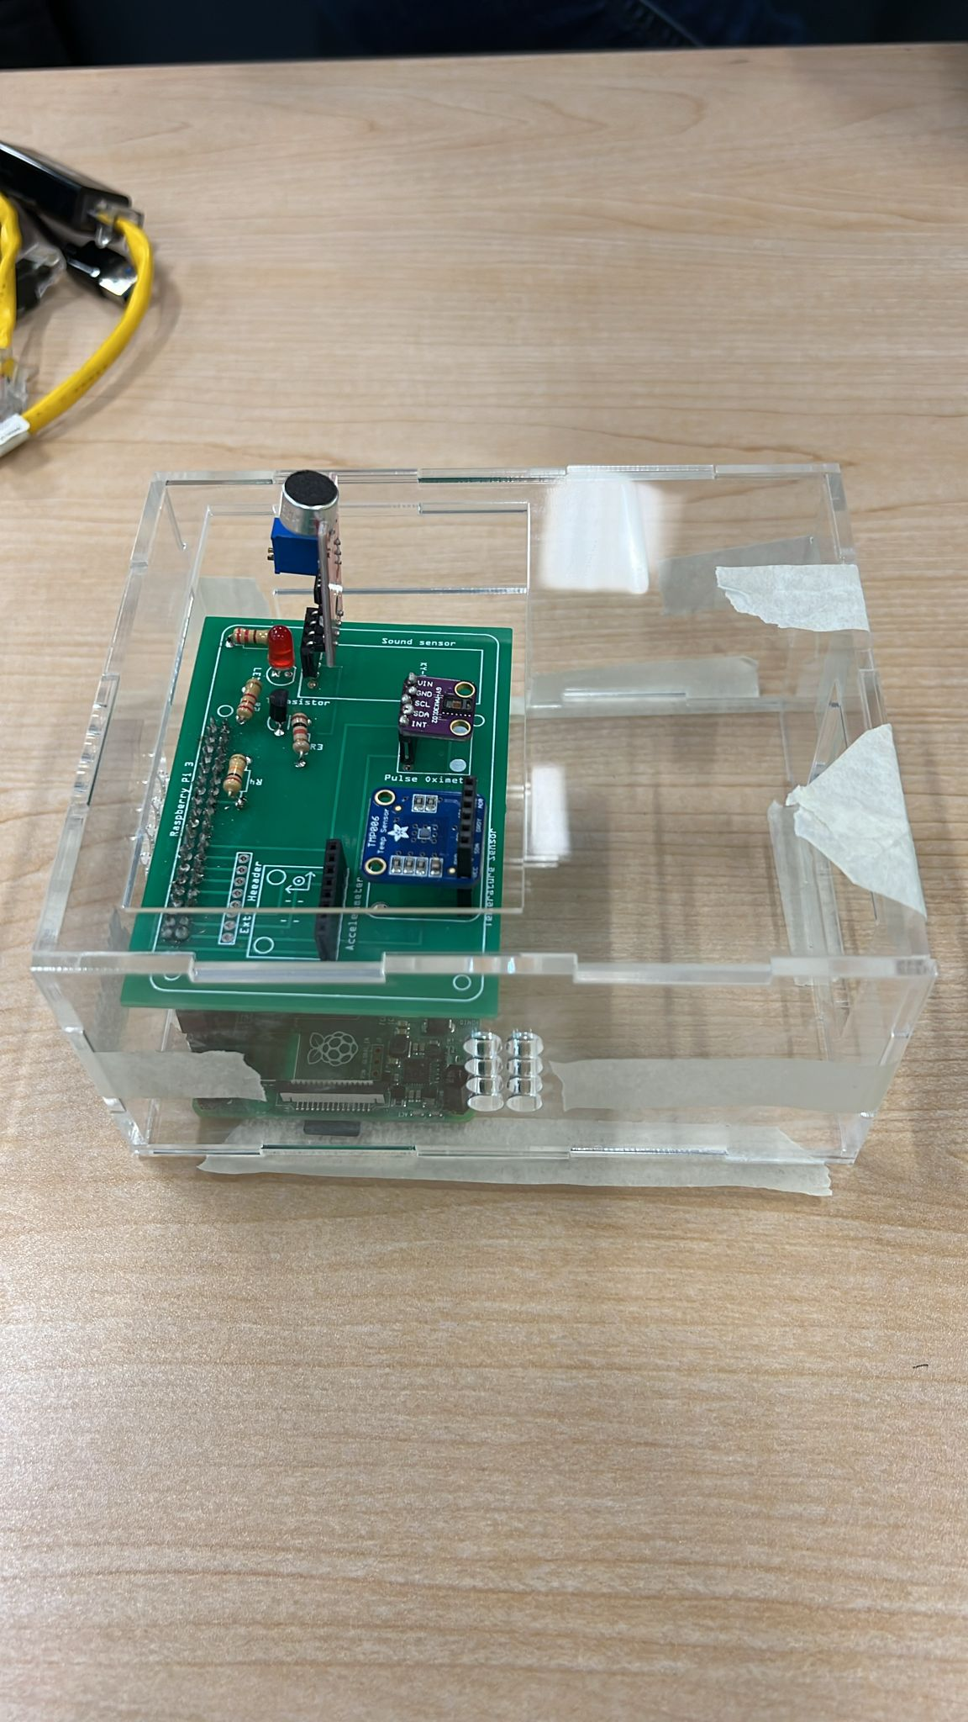
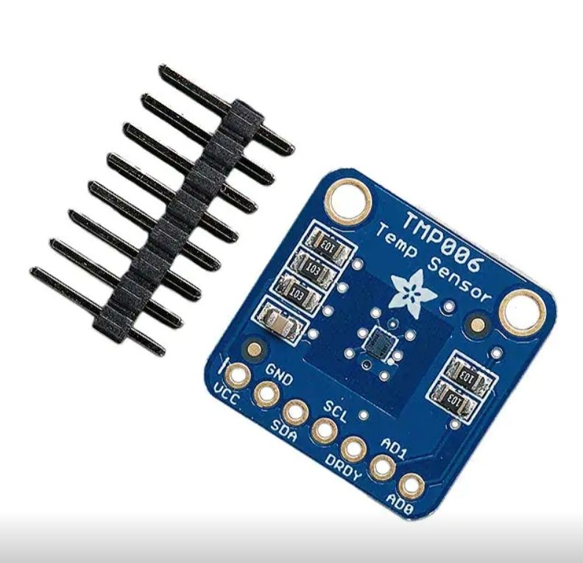
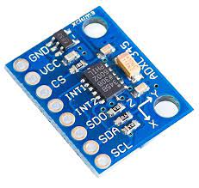
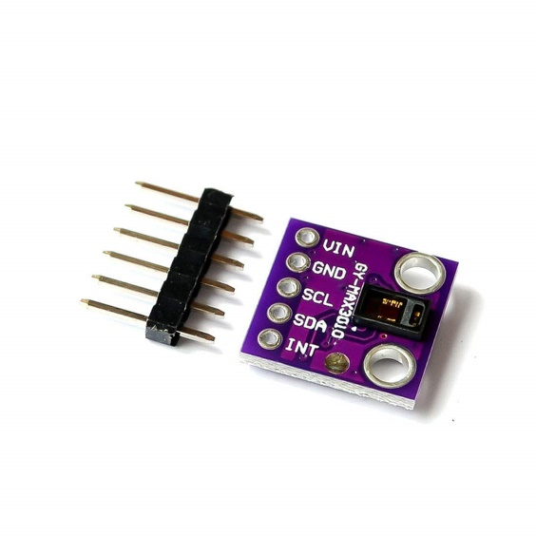
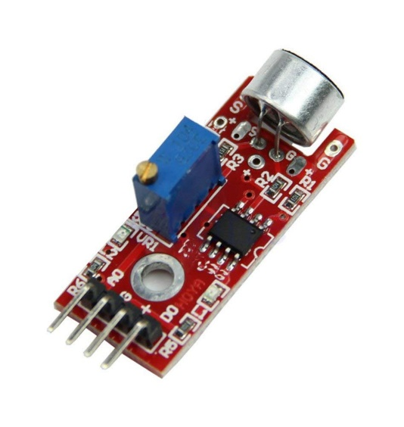
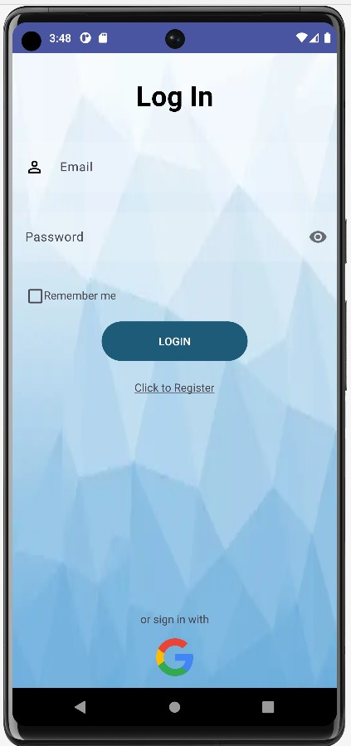
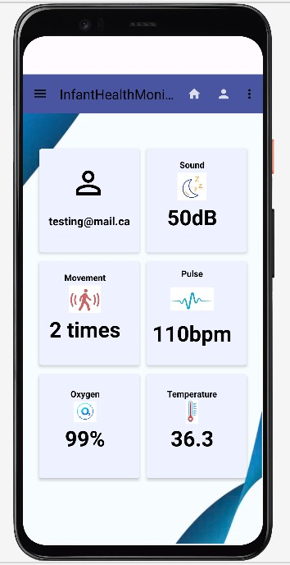
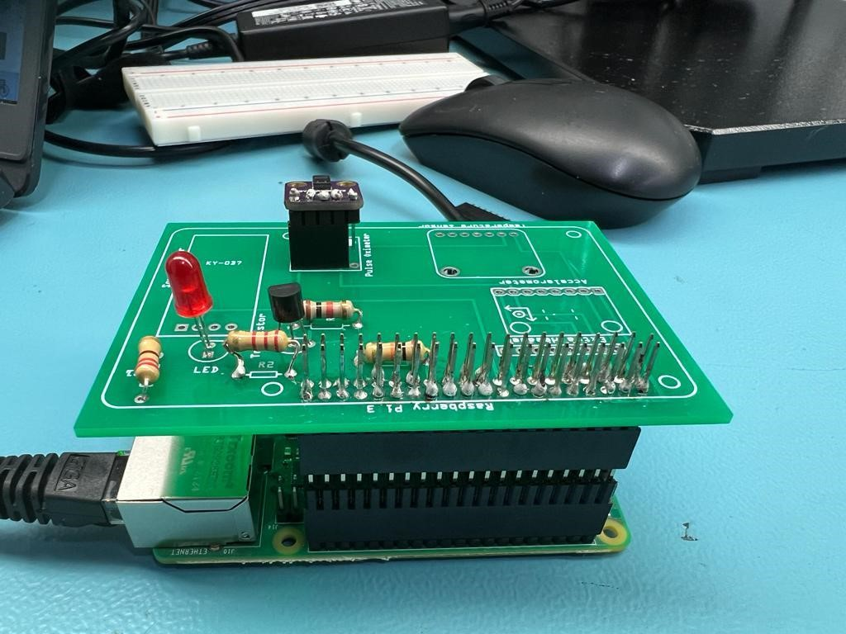
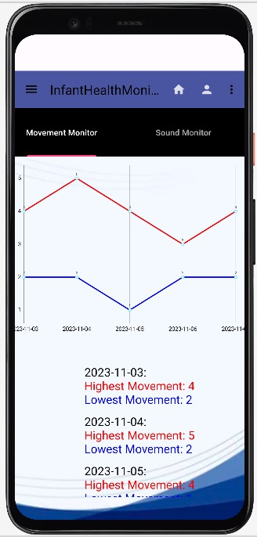
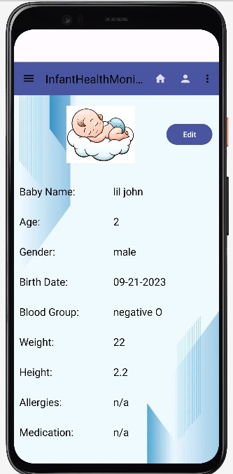
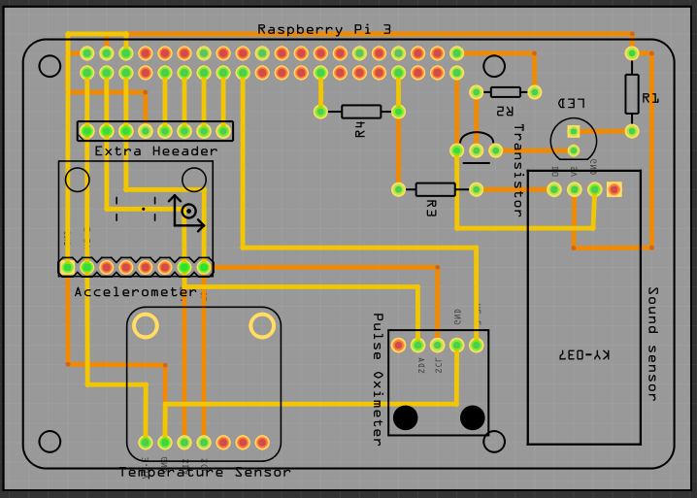
Smart Infant Health Monitor (SIHMON)
Naman Pal, Zoyeba Mahbub, Satinder Kaur, Eshan Salwan
Faculty of Applied Sciences and Technology, Humber College
INTRODUCTION
HARDWARE DEVELOPMENT
MOBILE APPLICATION
MANUFACTURING
Welcome to a revolutionary era in caregiving with our capstone innovation – the Smart Infant Health Monitor (SIHMON) App, powered by a Raspberry Pi Computer and our PCB (printed circuit board).
SIHMON monitors infant’s health in real-time through our user-friendly mobile app using sensors.
It empowers both parents and healthcare providers to effortlessly nurture the well-being of our little ones.
SIHMON uses the following sensors: -
We followed a hybrid Agile-Waterfall approach to develop the hardware solution: -
Selected optimal sensors to monitor infants’ health.
Developed and unit-tested our circuit on a breadboard.
Designed PCB (printed circuit board) using Fritzing.
Collaborated with PCB production vendor to manufacture the PCB.
Programmed the computer (Raspberry Pi) to collect the infant’s health data from the sensors and record it into the database (Firebase) using Python.
Rigorously tested the prototype.
,
The main functions of the application include
Secure login for parents and health professionals.
Home page with card-based layout for sensors.
Analytics page to track daily health statistics.
The team followed the Agile-DevOps approach to develop the mobile application: -
Used Android Studio and Java to develop the app.
Used navigation drawer to design user interface.
Added scroll views and graphs to enhance UI/UX.
Used Junit, Selenium, and Espresso to test the code.
We are excited to present a live demonstration featuring a 3D-printed acrylic box designed using CorelDRAW.
Witness the seamless integration of the sensors, PCB, mobile app, and computer (Raspberry Pi).
This prototype emulates the complete functionality of our final product (the actual health band).
Android studio. (2023) Screenshot of Login Page of Infant Health Monitor
TMP006
ADXL345
MAX30102
LM393
CONCLUSION
TMP006: Continuous monitoring child’s temperature.
ADXL345: Movement detection for monitoring infant activity levels.
MAX30102: Monitoring heart rate and blood oxygen level.
LM393: Cry detection to alert caregivers for prompt attention to the baby's needs.
Android studio. (2023) Screenshot of Home Screen of Infant Health Monitor
In a nutshell, SIHMON is more than just a capstone project; it is an innovation which will make a real impact in the lives of parents worldwide.
We have successfully completed the prototype stage. Our future plans include miniaturization of the sensors so they can fit within a band worn by the infant.
Testing heart rate and blood oxygen sensor with PCB and Raspberry Pi.
Android studio. (2023) Screenshot of Motion Screen of Infant Health Monitor
AIM
ACKNOWLEDGEMENTS
Provide parents/caregivers with a convenient way to: -
Monitor and track their infant’s health in real time.
Receive alerts if anything seems unusual.
Ensure and hence improve their baby's well-being.
Thanks to Professors Ali Maki, Kristian Medri, Meirion Williams, and Haki Sharifi for guiding our project. Special appreciation to FAST for their vital support in making SIHMON a reality.
Android studio. (2023) Screenshot of Profile Screen of Infant Health Monitor
Layout of PCB Board comprises all the four sensors in the Fritzing
Notes:
Hardware Development
The team followed a step-by-step approach develop the hardware solution
Carefully selected the optimal sensors to monitor the infants vital signs
Developed and unit tested bread board and code to collect data from the sensors
Designed our PCB using Fritzing
Collaborated with PCB production vendor to produce PDF design file used to manufacture the PCB
Confirmed PCB behavior by rigorously tested the PCB using a Digital Multimeter
Completed Integration and testing of the sensors with Raspberry Pi, and Raspberry Pi with the Firebase database
Mobile Application Development
The main functions of the application include
Secure login for parents and health professionals
Home page for with simple card-based layout, with one card to display the output for each monitor
Analytics page that track daily statistics (min and max readings) for each of the monitor
The team followed a more Agile / iterative approach to develop the mobile application
Used what to develop the mobile application (coding environment, language, etc)
Used what to design the user interface
Used what tools to test the code
How did you test each component of the code

